Slide 1

K Nearest Neighbor (KNN)
Aksadur Rahman
aksadur@yahoo.com

Slide 2
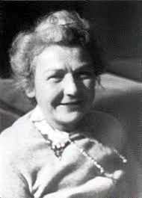
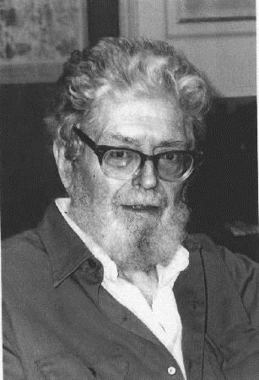
K Nearest Neighbor (KNN) Classifier
Evelyn Fix
Joseph Hodges

Slide 3
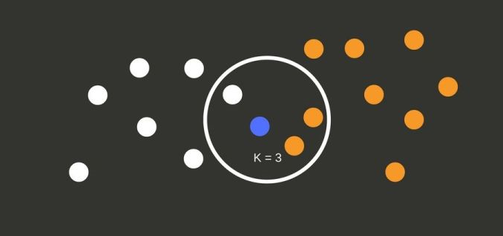
K Nearest Neighbor (KNN) Classifier
The k-nearest neighbors (KNN) algorithm is a simple, supervised machine learning algorithm that can be used to solve both classification and regression problems. It's easy to implement and understand

Slide 4
K Nearest Neighbor (KNN) Classifier
Problem-1
Training Data
Value-1 | Value-2 | Value-3 | Class
5 | 3 | 1 | A
2 | 4 | 2 | B
1 | 2 | 3 | B
4 | 3 | 2 | A
3 | 3 | 2 | A
1 | 3 | 2 | A
0 | 1 | 2 | B
Classify data pattern
using K-Nearest neighbor classifier, k=3
2 | 1 | 3 | ?

Slide 5
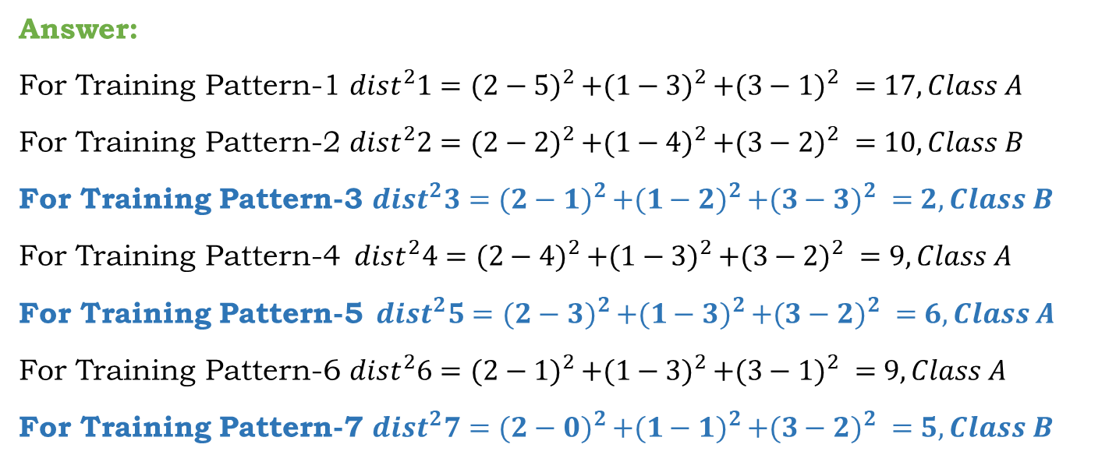
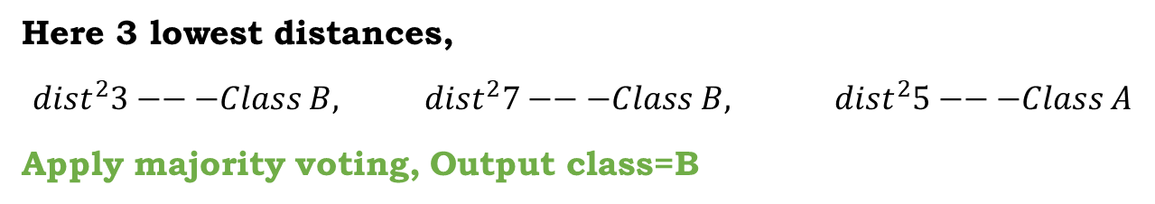
K Nearest Neighbor (KNN) Classifier
Answer:
For Training Pattern-1 ${dist}^{2}1={(2−5)}^{2 }+{(1−3)}^{2 }+{(3−1)}^{2 }=17, Class A$
For Training Pattern-2 ${dist}^{2}2={(2−2)}^{2 }+{(1−4)}^{2 }+{(3−2)}^{2 }=10, Class B$
For Training Pattern-3 ${dist}^{2}3={(2−1)}^{2 }+{(1−2)}^{2 }+{(3−3)}^{2 }=2, Class B$
For Training Pattern-4${ dist}^{2}4={(2−4)}^{2 }+{(1−3)}^{2 }+{(3−2)}^{2 }=9, Class A$
For Training Pattern-5${ dist}^{2}5={(2−3)}^{2 }+{(1−3)}^{2 }+{(3−2)}^{2 }=6, Class A$
For Training Pattern-6 ${dist}^{2}6={(2−1)}^{2 }+{(1−3)}^{2 }+{(3−1)}^{2 }=9, Class A$
For Training Pattern-7 ${dist}^{2}7={(2−0)}^{2 }+{(1−1)}^{2 }+{(3−2)}^{2 }=5, Class B$
Here 3 lowest distances,
${dist}^{2}3−−−Class B, {dist}^{2}7−−−Class B, { dist}^{2}5−−−Class A$
Apply majority voting, Output class=B

Slide 6
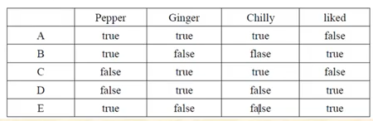
K Nearest Neighbor (KNN) Classifier
Problem-2
Classify the liked for the following data K=3

Slide 7
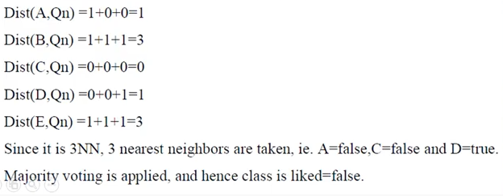
K Nearest Neighbor (KNN) Classifier
Answer

Slide 8
K Nearest Neighbor (KNN) Classifier
Problem-3
Name | Gender | Height | Output
Kristina | F | 1.6 | Short
Jim | M | 2 | Tall
Maggie | F | 1.9 | Medium
Martha | F | 1.88 | Medium
Stephine | F | 1.7 | Short
Bob | M | 1.85 | Medium
Kathy | F | 1.6 | Short
Dave | M | 1.7 | Short
Worth | M | 2.2 | Tall
Steven | M | 2.2 | Tall
Debbie | F | 1.8 | Medium
Todd | M | 1.95 | Medium
Amy | F | 1.9 | Medium
Kim | F | 1.8 | Medium
Wynette | F | 1.75 | Medium
Using the sample data from Table and the Output classification as the training set output value, we classify the instance (Pat, F, 1.6). Suppose that K = 5 is given.

Slide 9
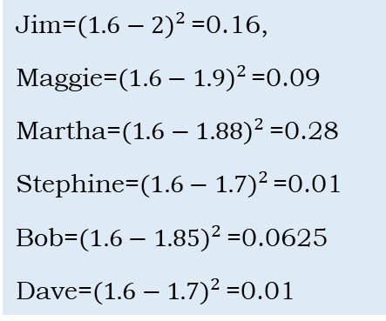
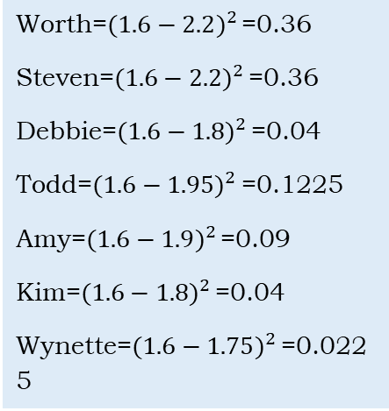
K Nearest Neighbor (KNN) Classifier
Side Note
Answer
Jim=${(1.6−2)}^{2 }$=0.16,
Maggie=${(1.6−1.9)}^{2 }$=0.09
Martha=${(1.6−1.88)}^{2 }$=0.28
Stephine=${(1.6−1.7)}^{2 }$=0.01
Bob=${(1.6−1.85)}^{2 }$=0.0625
Dave=${(1.6−1.7)}^{2 }$=0.01
Name | Gender | Height | Output | Distance with Pat (1.6)
Kristina | F | 1.6 | Short | 0
Jim | M | 2 | Tall | 0.16
Maggie | F | 1.9 | Medium | 0.09
Martha | F | 1.88 | Medium | 0.28
Stephine | F | 1.7 | Short | 0.01
Bob | M | 1.85 | Medium | 0.0625
Kathy | F | 1.6 | Short | 0
Dave | M | 1.7 | Short | 0.01
Worth | M | 2.2 | Tall | 0.36
Steven | M | 2.2 | Tall | 0.36
Debbie | F | 1.8 | Medium | 0.04
Todd | M | 1.95 | Medium | 0.1225
Amy | F | 1.9 | Medium | 0.09
Kim | F | 1.8 | Medium | 0.04
Wynette | F | 1.75 | Medium | 0.0225
Worth=${(1.6−2.2)}^{2 }$=0.36
Steven=${(1.6−2.2)}^{2 }$=0.36
Debbie=${(1.6−1.8)}^{2 }$=0.04
Todd=${(1.6−1.95)}^{2 }$=0.1225
Amy=${(1.6−1.9)}^{2 }$=0.09
Kim=${(1.6−1.8)}^{2 }$=0.04
Wynette=${(1.6−1.75)}^{2 }$=0.0225

Slide 10
K Nearest Neighbor (KNN) Classifier
We then have that the K nearest neighbours to the input instance are
(Kristina, F, 1.6)--------- Short
(Kathy, F, 1.6) ------------Short
(Stephanie, F, 1.7) -------Short
(Dave, M, 1.7) -------------Short
(Wynette, F, 1.75)---------Medium
And Output “Short” is for 4 times and “Medium” is only one time. After voting Result is, Pat F 1.6 = “Short”

